Slide 1


Hugo Hernández
02/16/2022

Slide 2

Outline
Executive Summary
Introduction
Methodology
Results
Conclusion
Appendix

Slide 3
Executive Summary
The methods used in this project include:
Data collection using APIs, SQL and Web Scraping.
Data Wrangling
EDA with Data Visualization and SQL
Creating interactive maps using Folium
Building interactive dashboards using Dash
Classification using ML
Project's main results:
The best classifier was the Decission Tree.
It had an accuracy of 88% on the test set.
Low weighted payloads perform better than the heavier payloads
The success rate improved during the years 2013-2020.

Slide 4
Executive Summary
The methods used in this project include:
Data collection using APIs, SQL and Web Scraping.
Data Wrangling
EDA with Data Visualization and SQL
Creating interactive maps using Folium
Building interactive dashboards using Dash
Classification using ML
Project's main results:
The best classifier was the Decission Tree.
It had an accuracy of 88% on the test set.
Low weighted payloads perform better than the heavier payloads.
The success rate improved during the years 2013-2020.

Slide 5
Introduction
As a company that wants to bid against SpaceX for rocket launches, it would be useful to predict the cost of Falcon 9 launches.
SpaceX advertises Falcon 9 rocket launches much cheaper than competitors, much of the savings are because SpaceX can reuse the first stage.
Therefore, if we can determine if the first stage will land, we can determine the cost of a launch.
Mail goals:
Predict whether a new launch will land succesfuly.
Find the correlation between launch attributes and outcome of landing.

Slide 6

Section 1

Slide 7
Methodology
Executive Summary
Data collection methodology:
Using SpaceX Rest API. [1]
Web Scraping from Wikipedia. [2]
Perform data wrangling
Irrelevant columns were dropped.
Data types were assesed and corrected.
NaN or null values were replaced with column mean value.
One Hot Encoding was used to prepare categorical columns for ML.

Slide 8
Methodology
Executive Summary
Perform exploratory data analysis (EDA) using visualization and SQL
Perform interactive visual analytics using Folium and Plotly Dash

Slide 9
Methodology
Executive Summary
Perform predictive analysis using classification models
SVM, Logistic Regression, Decission Tree, KNN.
Hyperparemeter tuning using GridSearchCV on a dev set.
Best model found using accuracy on a test set.

Slide 10
Data Collection
Data sets were downloaded from the internet using the SpaceX Rest API and using Web Scraping.
Filtering and cleaning were applied.
The data was stored as .csv files.
Getting data
Filtering
Saving as csv

Slide 11
Data Collection – SpaceX API
The launch data was gathered from the SpaceX REST API using GET.
Receive response as a .json file.
Convert json response to Pandas DataFrame.
Filtering and Data Wrangling.
Store data as .csv file.
A Jupyter Notebook was used for the process. [3]
Apply filters
Send GET request to API
Convert response to .json and parse data
Create Pandas DataFrame
Export to .csv file

Slide 12
Data Collection - Scraping
The launch data was gathered from Wikipedia. [2]
Create BeautifulSoup object with response.
Find all tables within the object.
Create dictionary with the table data.
Create Pandas DataFrame using the dictionary.
Store data as .csv file.
A Jupyter Notebook was used for the process. [4]
Convert dict to dataframe.
Get HTML response.
Create BS4 object.
Parse tables and create dictionary.
Export to .csv file

Slide 13
Data Wrangling
Data was loaded from a .csv file and stores as a Pandas DataFrame.
Dealing with null values.
Fixed columns with wrong data types.
Convert Landing Outcome as Boolean type.
Export to .csv file.
A Jupyter Notebook was used for the process. [5]
Create label column
Load data
Fix missing values
Fix wrong dtypes
Export to .csv file

Slide 14
EDA with Data Visualization
Scatter plot between Flight Number and Launch Site, with Outcome as label: helps to visualize the relationship between SpaceX flight experience and Success.
Scatter plot between Payload and Launch Site: helps to visualize the relationship between the Payload mass carried and Success.
Bar plot of success rate for each orbit type: checks if there is any relationship between success rate and orbit type.
Scatter plot between Flight Number and Orbit type: helps to visualize the relationship between SpaceX flight experience and Success.
Scatter plot between Payload and Orbit type: helps to visualize the relationship between the Payload mass carried and Success.
Line plot for launch success yearly trend: to visualize change in success rate over the years.
A Jupyter Notebook was used for the process. [6]

Slide 15
EDA with SQL
Display the names of the unique launch sites in the space mission.
Display five records where launch sites begin with the string 'KSC’.
Display the total payload mass carried by boosters launched by NASA (CRS).
Display average payload mass carried by booster version F9 v1.1.
List the date where the successful landing outcome in drone ship was achieved.
List the names of the boosters which have success in ground pad and have payload mass greater than 4000 but less than 6000.
List the total number of successful and failure mission outcomes.

Slide 16
EDA with SQL
List the names of the booster versions which have carried the maximum payload mass.
List the records which will display the month names, successful landing outcomes in ground pad ,booster versions, launch site for the months in year 2017.
Rank the count of successful landing outcomes between the date 2010-06-04 and 2017-03-20 in descending order.
A Jupyter Notebook was used for the process. [7]

Slide 17
Build an Interactive Map with Folium
To visualize the data of each launch site we added a Circle Marker around each launch site with a label of the name of the launch site.
Different color was used for launch sites with success or failed landings.
Created Marker Clusters to simplify the map.
Created lines and measured the distance from launch site to certain landmarks.
A Jupyter Notebook was used for the process. [8]

Slide 18
Build a Dashboard with Plotly Dash
A dashboard was created for interactive visualization:
The dashboard contained:
Pie Chart showing the percentage of launches in each site
Pie Chart showing success rate of each site
Scatter Graph for the Outcome vs. Payload Mass (Kg) for different Booster Versions
A Jupyter Notebook was used for the process. [9]

Slide 19
Predictive Analysis (Classification)
Perform predictive analysis using four classification models
SVM, Logistic Regression, Decission Tree, KNN.
Check accuracy for each model.
Hyperparemeter tuning using GridSearchCV on a dev set.
Best model found using accuracy on a dev set.
Assess model score using accuracy on a test set.
A Jupyter Notebook was used for the process. [10]
Training models
GridSearchCV
Choose best model using dev set
Assess accuracy using test set

Slide 20
Results
Exploratory data analysis results
Interactive analytics demo in screenshots
Predictive analysis results

Slide 21

Section 2

Slide 22
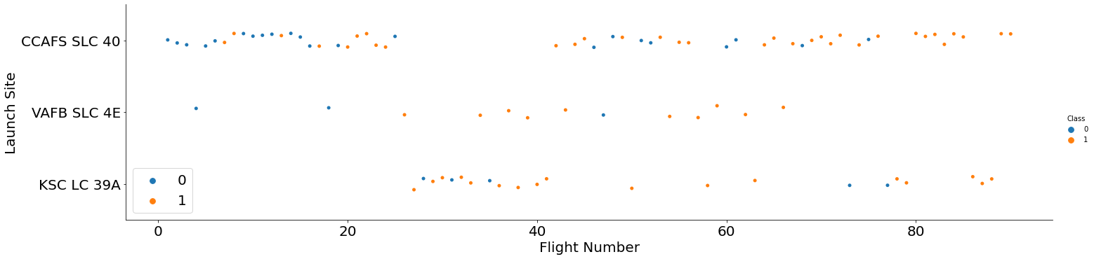
Flight Number vs. Launch Site
• Launches from the site of CCAFS SLC 40 are significantly higher than launches form other sites.

Slide 23
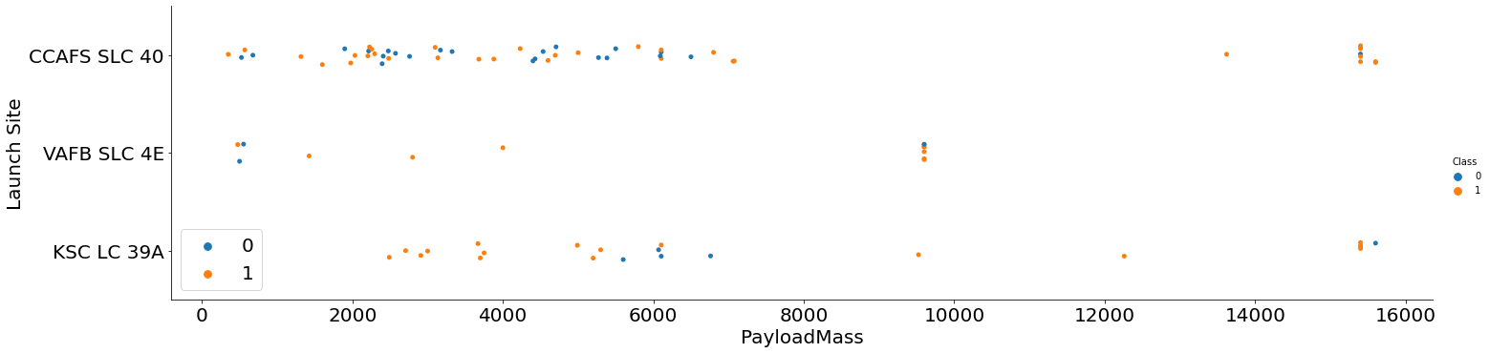
Payload Mass vs. Launch Site
• In the VAFB-SLC launchsite there are no rockets launched for heavypayload mass(greater than 10000).

Slide 24
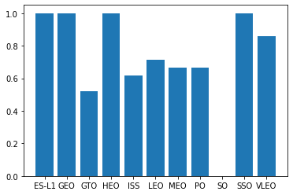
Success Rate vs. Orbit Type
Different orbits have different mean success rates.

Slide 25
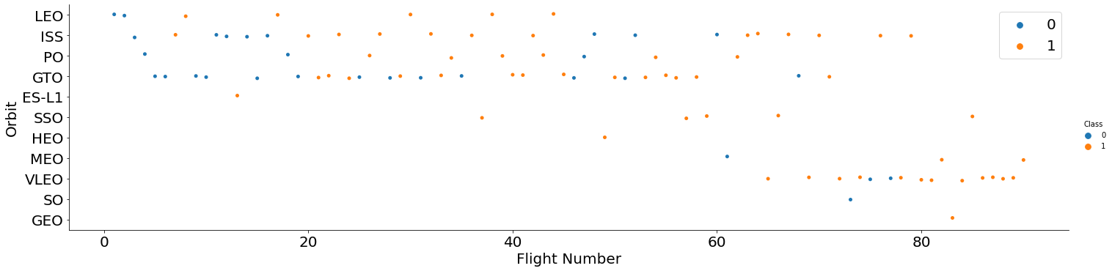
Flight Number vs. Orbit Type
In the LEO orbit the Success appears related to the number of flights; on the other hand, there seems to be no relationship between flight number when in GTO orbit.

Slide 26
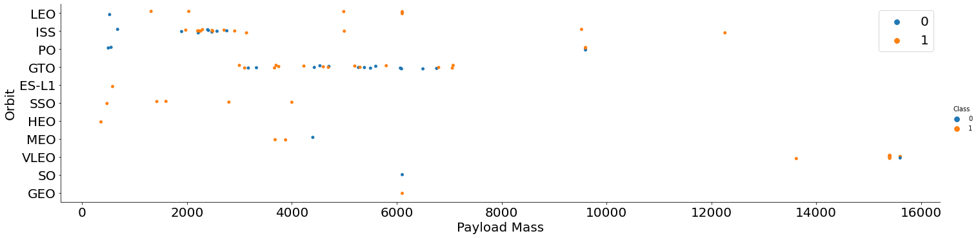
Payload vs. Orbit Type
With heavy payloads the successful landing or positive landing rate are more for Polar, LEO and ISS.

Slide 27
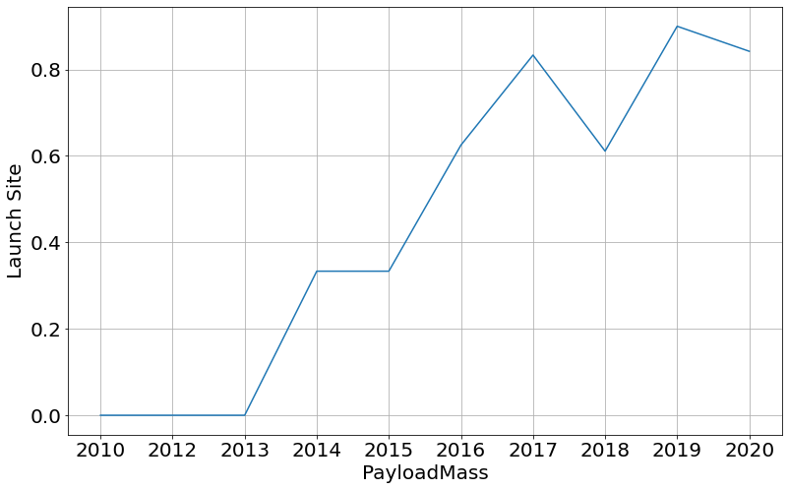
Launch Success Yearly Trend
The sucess rate since 2013 kept increasing till 2020

Slide 28
All Launch Site Names
All the names of the sites of the Falcon 9 launches.
Launch Site
CCAFS LC-40
VAFB SLC-4E
KSC LC-39A
CCAFS SLC-40

Slide 29
Launch Site Names Begin with 'CCA'
Find 5 records where launch sites begin with `CCA`
index | Date | Time (UTC) | Booster_Version | Launch_Site | Payload | PAYLOAD_MASS__KG_ | Orbit | Customer | Mission_Outcome | Landing_Outcome
0 | 04-06-2010 | 18:45:00 | F9 v1.0 B0003 | CCAFS LC-40 | Dragon Spacecraft... | 0 | LEO | SpaceX | Success | Failure (parachute)
1 | 08-12-2010 | 15:43:00 | F9 v1.0 B0004 | CCAFS LC-40 | Dragon demo flight C1... | 0 | LEO (ISS) | NASA (COTS) NRO | Success | Failure (parachute)
2 | 22-05-2012 | 07:44:00 | F9 v1.0 B0005 | CCAFS LC-40 | Dragon demo flight C2 | 525 | LEO (ISS) | NASA (COTS) | Success | No attempt
3 | 08-10-2012 | 00:35:00 | F9 v1.0 B0006 | CCAFS LC-40 | SpaceX CRS-1 | 500 | LEO (ISS) | NASA (CRS) | Success | No attempt
4 | 01-03-2013 | 15:10:00 | F9 v1.0 B0007 | CCAFS LC-40 | SpaceX CRS-2 | 677 | LEO (ISS) | NASA (CRS) | Success | No attempt

Slide 30
Total Payload Mass
Calculate the total payload carried by boosters from NASA
SUM(PAYLOAD_MASS__KG_)
48213

Slide 31
Average Payload Mass by F9 v1.1
Calculate the average payload mass carried by booster version F9 v1.1
AVG(PAYLOAD_MASS__KG_)
2534.67

Slide 32
First Successful Ground Landing Date
Find the dates of the first successful landing outcome on ground pad
MIN(Date)
01-05-2017

Slide 33
Successful Drone Ship Landing with Payload between 4000 and 6000
List the names of boosters which have successfully landed on drone ship and had payload mass greater than 4000 but less than 6000
Date | Landing_Outcome | PAYLOAD_MASS_KG | Booster_Version
06-05-2016 | Success (drone ship) | 4696 | F9 FT B1022
14-08-2016 | Success (drone ship) | 4600 | F9 FT B1026
30-03-2017 | Success (drone ship) | 5300 | F9 FT B1021.2
11-10-2017 | Success (drone ship) | 5200 | F9 FT B1031.2

Slide 34
Total Number of Successful and Failure Mission Outcomes
Calculate the total number of successful and failure mission outcomes
Success: 98
Failure (in flight): 1
Success (payload status unclear): 1

Slide 35
Boosters Carried Maximum Payload
Booster_Version | PAYLOAD_MASS_KG
F9 B5 B1048.4 | 15600
F9 B5 B1049.4 | 15600
F9 B5 B1051.3 | 15600
F9 B5 B1056.4 | 15600
F9 B5 B1048.5 | 15600
F9 B5 B1051.4 | 15600
F9 B5 B1049.5 | 15600
F9 B5 B1060.2 | 15600
F9 B5 B1058.3 | 15600
F9 B5 B1051.6 | 15600
F9 B5 B1060.3 | 15600
F9 B5 B1049.7 | 15600
List the names of the booster which have carried the maximum payload mass

Slide 36
2015 Launch Records
List the failed landing outcomes in drone ship, their booster versions, and launch site names for in year 2015
Date | Landing_Outcome | Booster_Version | Launch_Site
10-01-2015 | Failure (drone ship) | F9 v1.1 B1012 | CCAFS LC-40
14-04-2015 | Failure (drone ship) | F9 v1.1 B1015 | CCAFS LC-40

Slide 37
Rank Landing Outcomes Between 2010-06-04 and 2017-03-20
Rank the count of landing outcomes (such as Failure (drone ship) or Success (ground pad)) between the date 2010-06-04 and 2017-03-20, in descending order
Landing_Outcome | Count
Success | 19
No attempt | 9
Success (drone ship) | 8
Success (ground pad) | 6
Failure (drone ship) | 4
Failure | 3
Controlled (ocean) | 3
No attempt | 1
Failure (parachute) | 1

Slide 38

Section 3

Slide 39
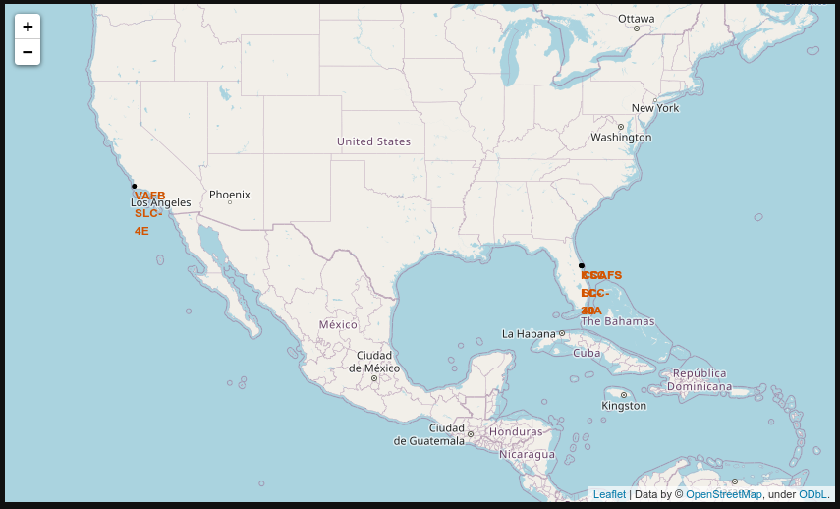
Falcon 9 Launch Sites
Map showing Falcon 9 launch sites

Slide 40
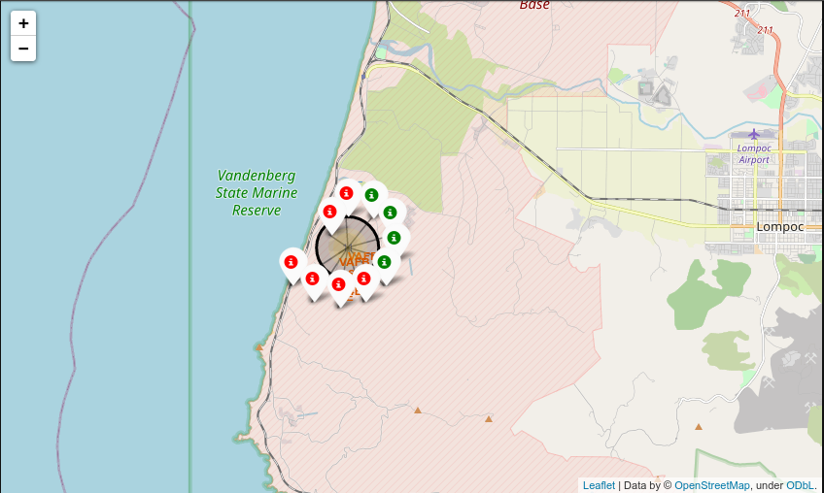
Success and failed Launch Sites
The successful launch sites are marked in green, and failed in red.

Slide 41
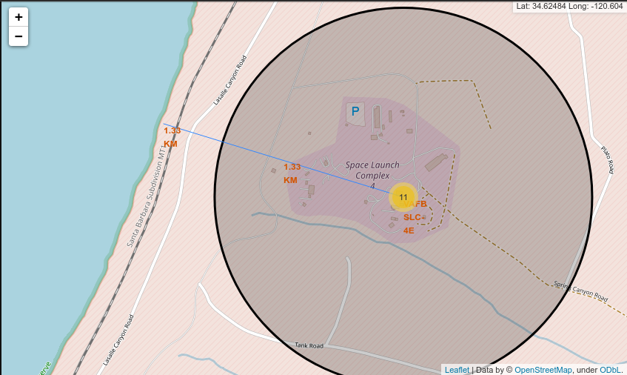
Distance from coastline to launch site.
Distance from launch site to coastline.

Slide 42

Section 4

Slide 43
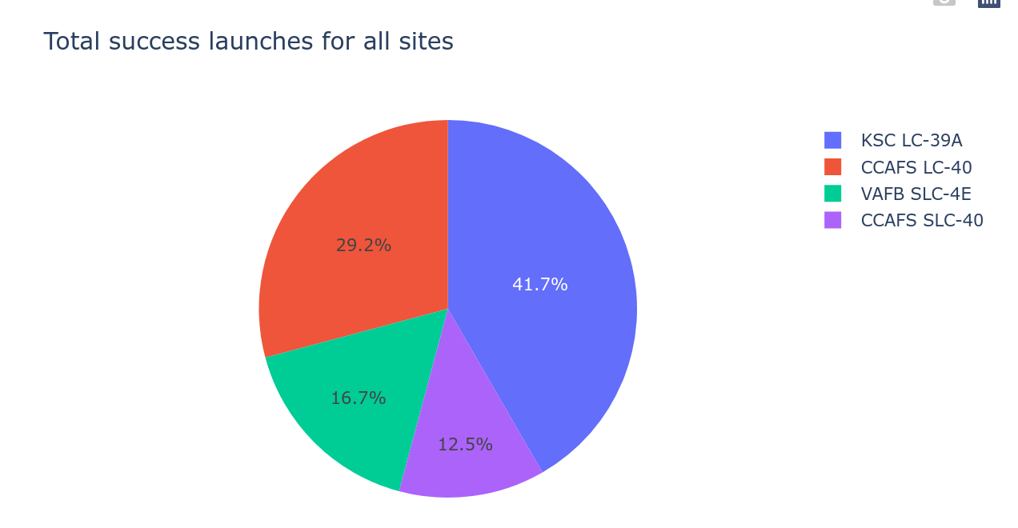
Launch success count for all sites

Slide 44
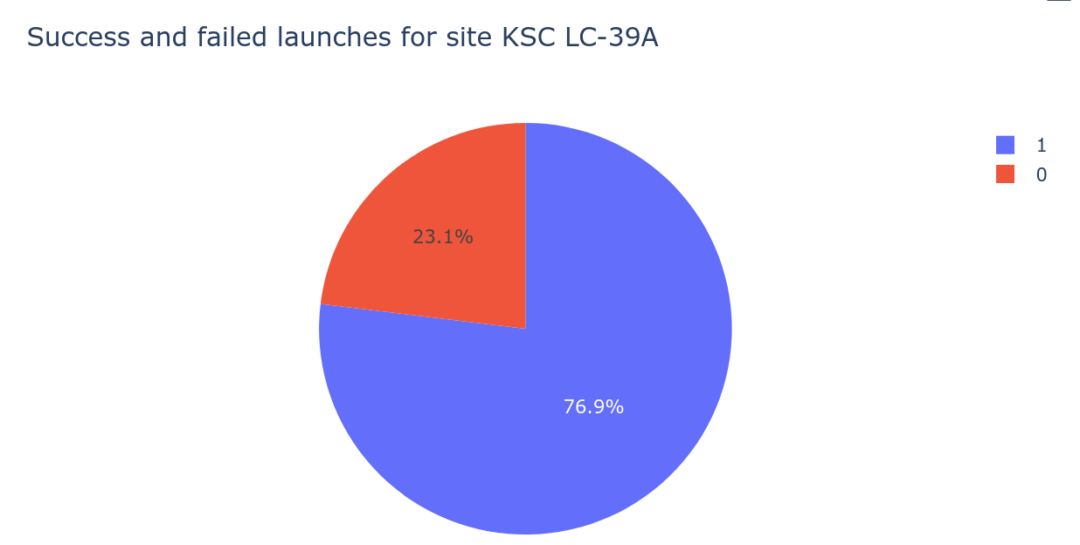
Launch site with highest success

Slide 45
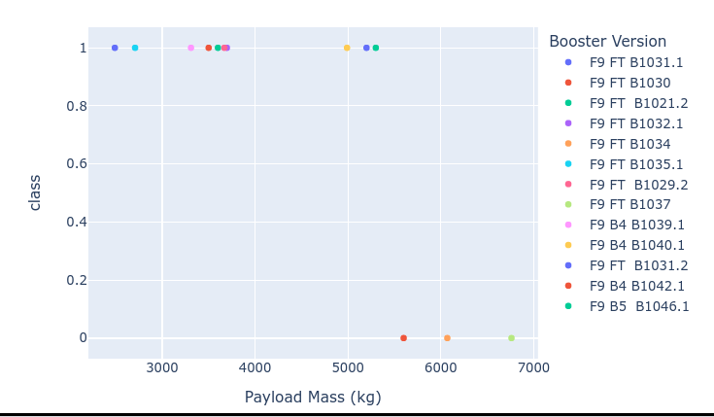
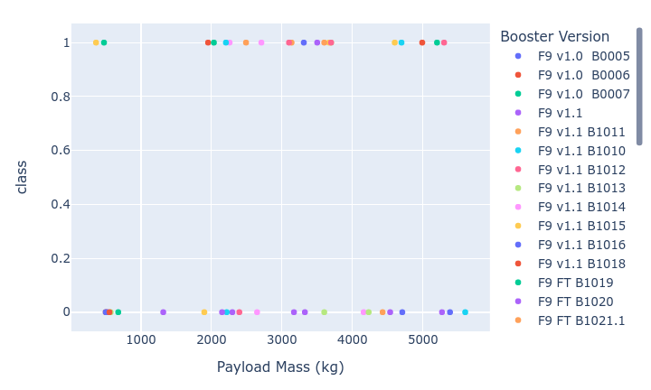
Success vs Payload mass

Slide 46

Section 5

Slide 47
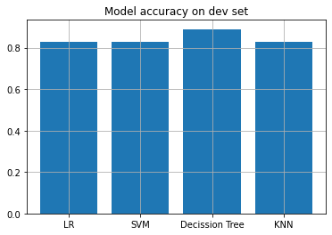
Classification Accuracy
Different models accuracy was found.
The model that performed best on the dev set was the Decission Tree Classifier with an accuracy of 0.88.
On the test set, the Decission Tree's accuracy was 0.89.

Slide 48
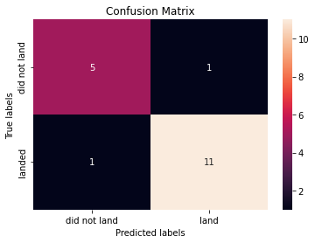
Confusion Matrix
The Decission Tree Classifier classified correctly eleven launches.
The Decission Tree Classifier had one False Positive and one False Negative.

Slide 49
Conclusions
The best classifier was the Decission Tree.
It had an accuracy of 88% on the test set.
Low weighted payloads perform better than the heavier payloads.
The success rate improved during the years 2013-2020.

Slide 50


